Slide 1


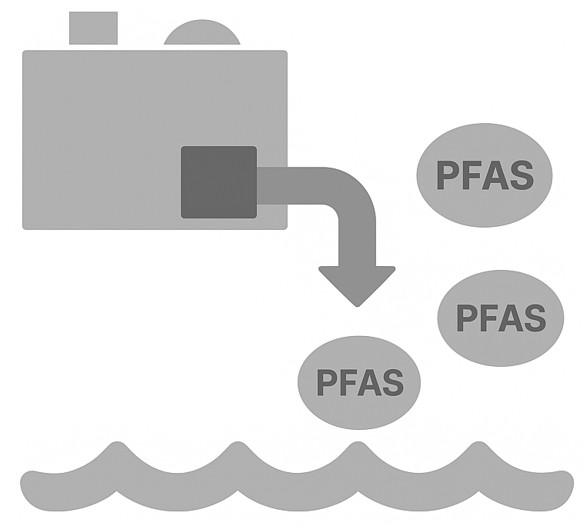

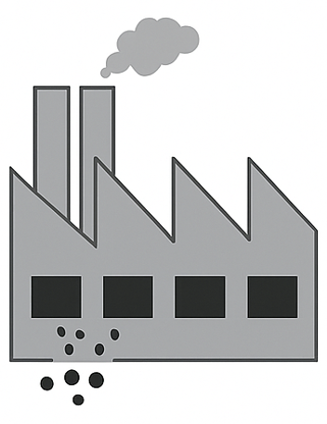




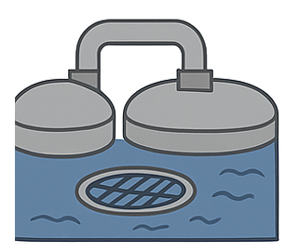

Kernels
Industry generates
PFASs waste
Agricultural Soil
Farm Family
Stover
Cattle
Corn
WWTP does not remove PFASs from water/biosolids
Biosolids applied to agricultural fields

Slide 2
PFOS
MUSCLE
BLOOD
LIVER
KIDNEY

Slide 3






Industry generates
PFASs waste
Landfill
WWTP does not remove PFASs from water/biosolids
Ground, surface for irrigation water
Impacted biosolids are land applied
Direct Land Application
Local and Homegrown Foods

